Slide 1




Identifying Diffuse Galaxies through Citizen Science
Nicolas Mazziotti
University of Arizona
Mentors: Prof. David Sand, Dr. Michael Jones
Arizona NASA Space Grant Consortium
April 22, 2023

Slide 2
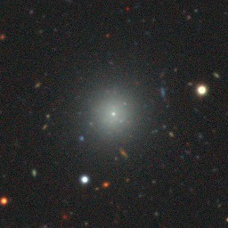
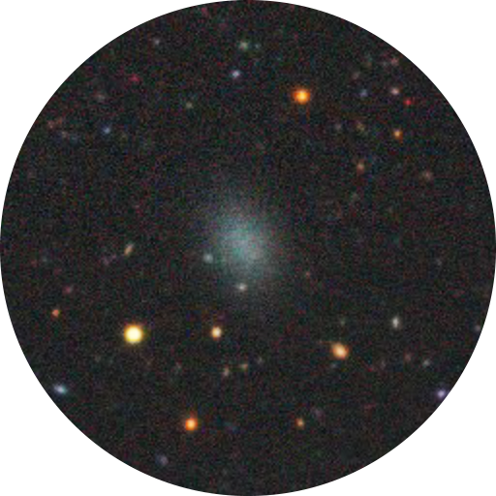


What are diffuse galaxies?
Type of dwarf galaxy
Properties:
  Have an effective radius similar to the Milky Way
  Low density of stars
  Can have a nuclear star cluster
Evolutionary history not well understood—need more examples
Nucleated
Non-nucleated
2
(Image Credit: DESI Legacy Imaging Surveys)

Slide 3
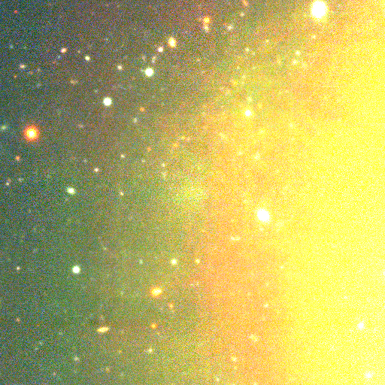
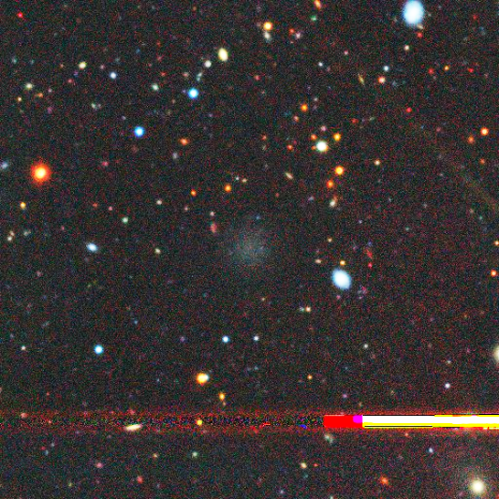
Limitations of Automated Detection
Computers might accidentally erase diffuse galaxies
Identification is still possible but isn’t 100% reliable
How do we know what these algorithms missing?
(Image Credit: Fornax Deep Survey/VLT Survey Telescope)
3

Slide 4
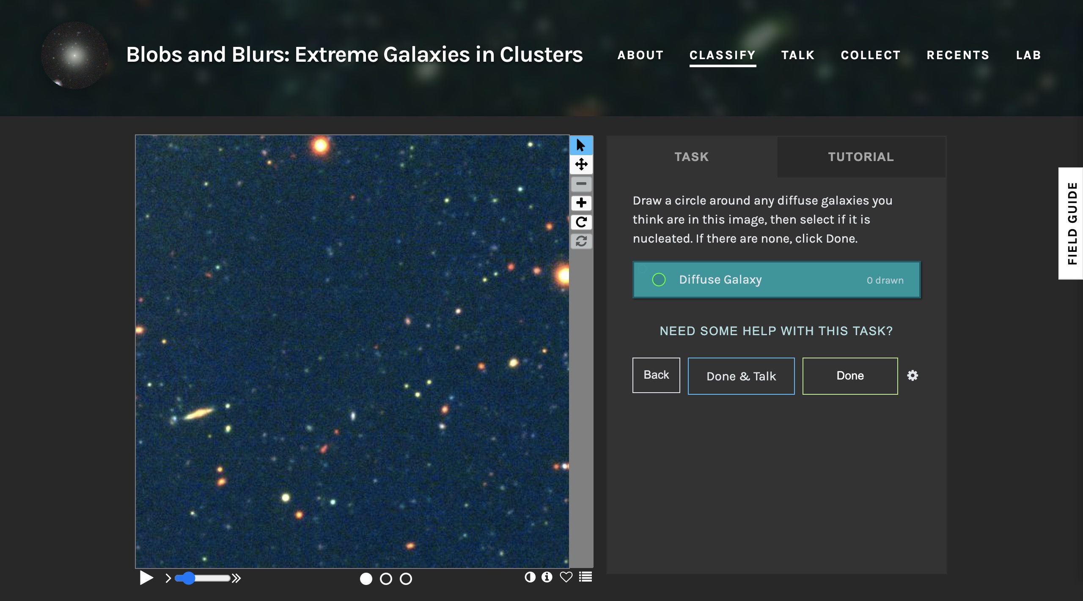

Alternative Method: Visual Identification
Drawbacks of visual identification:
  Can be time-consuming
  Logistically complex
How can we make visual identification a more practical method?
With a team of Citizen Scientists!
4

Slide 5
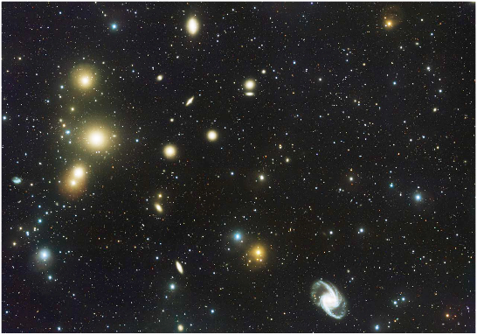
Using Zooniverse to examine the Fornax Cluster
Fornax is a large, nearby galaxy cluster
28 square degrees in the sky
We examined the F11 and F12 tiles of the Fornax Deep Survey (FDS)
(Image Credit: VLT Survey Telescope)
5

Slide 6
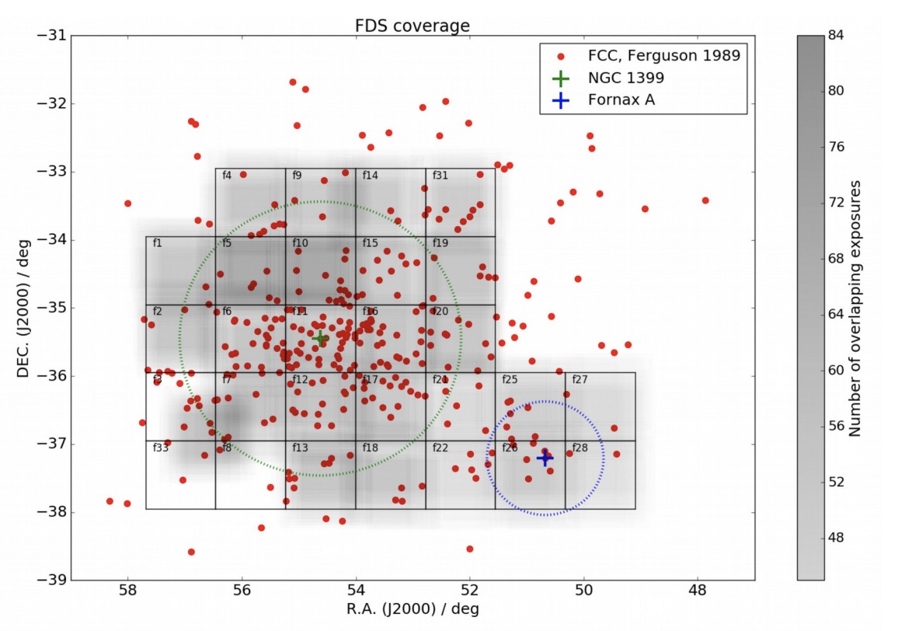
Using Zooniverse to examine the Fornax Cluster
Fornax is a large, nearby galaxy cluster
28 square degrees in the sky
We examined the F11 and F12 tiles of the Fornax Deep Survey (FDS)
(Image Credit: Peletier et al. 2020)
5

Slide 7
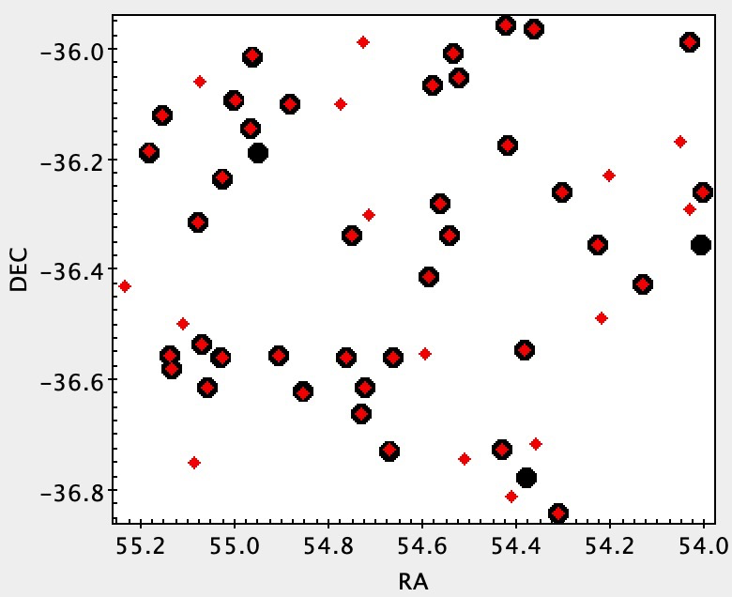
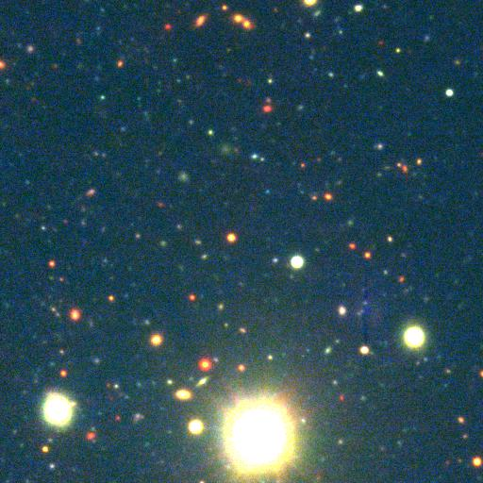
Results: F12 Tile
Compared with automated detection algorithm from Venhola et al. (2018, 2022)
Only used FDS optical data
Diffuse galaxies from algorithm
6
Our classifications

Slide 8
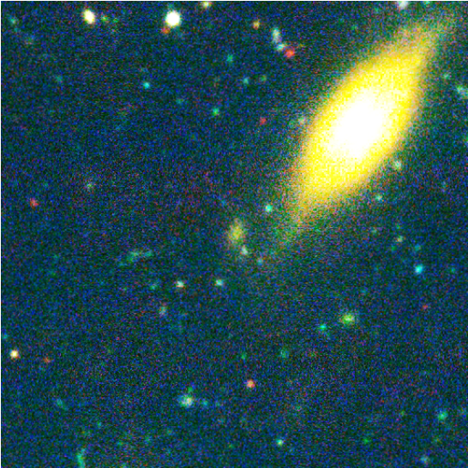
Results: F12 Tile
Unmatched object
Diffuse galaxies from algorithm
7
Our classifications

Slide 9
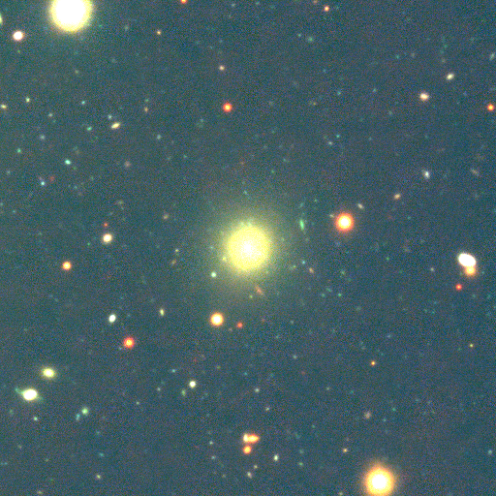
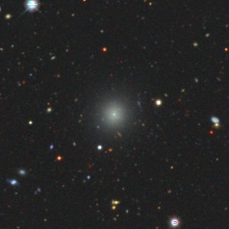
Missed object
Diffuse galaxies from algorithm
8
Our classifications

Slide 10
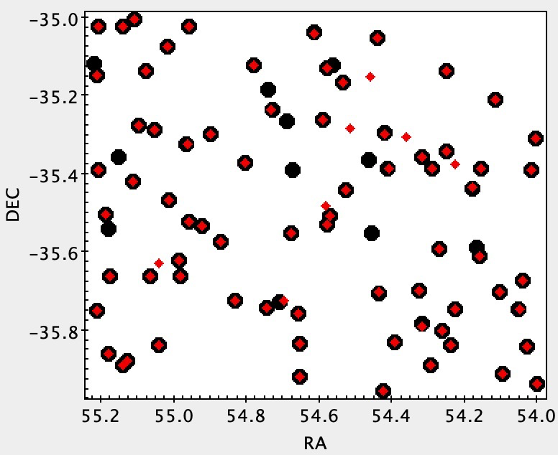
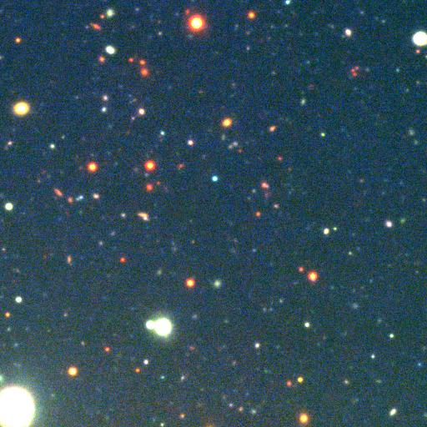
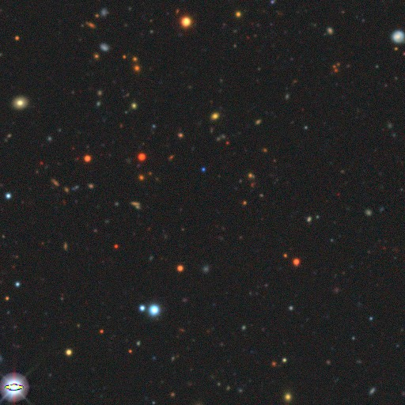
Results: F11 Tile
Added images from the Dark Energy Camera Legacy Survey (DECaLS) to help with search
FDS Image +
DECaLS Image
Diffuse galaxies from algorithm
9
Our classifications

Slide 11
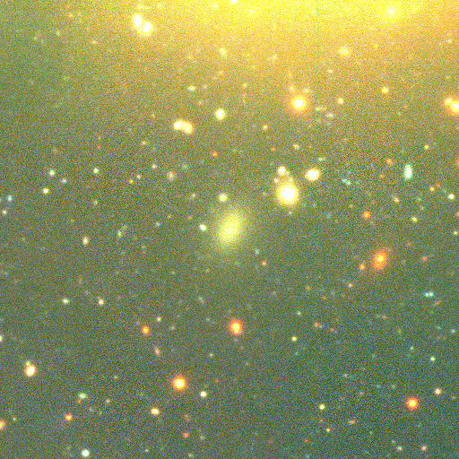
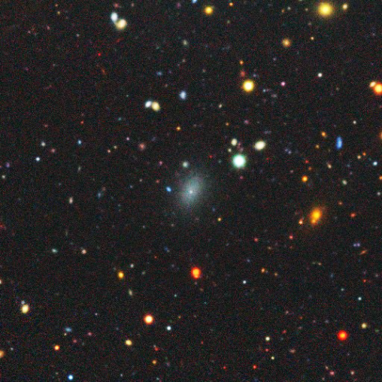
Unmatched object
Diffuse galaxies from algorithm
10
Our classifications

Slide 12
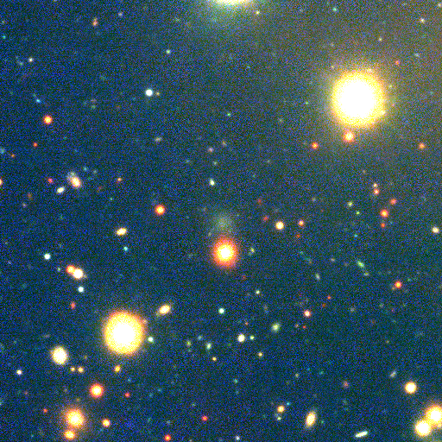
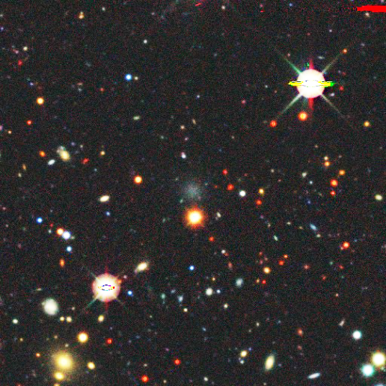
Unmatched object
Diffuse galaxies from algorithm
11
Our classifications

Slide 13
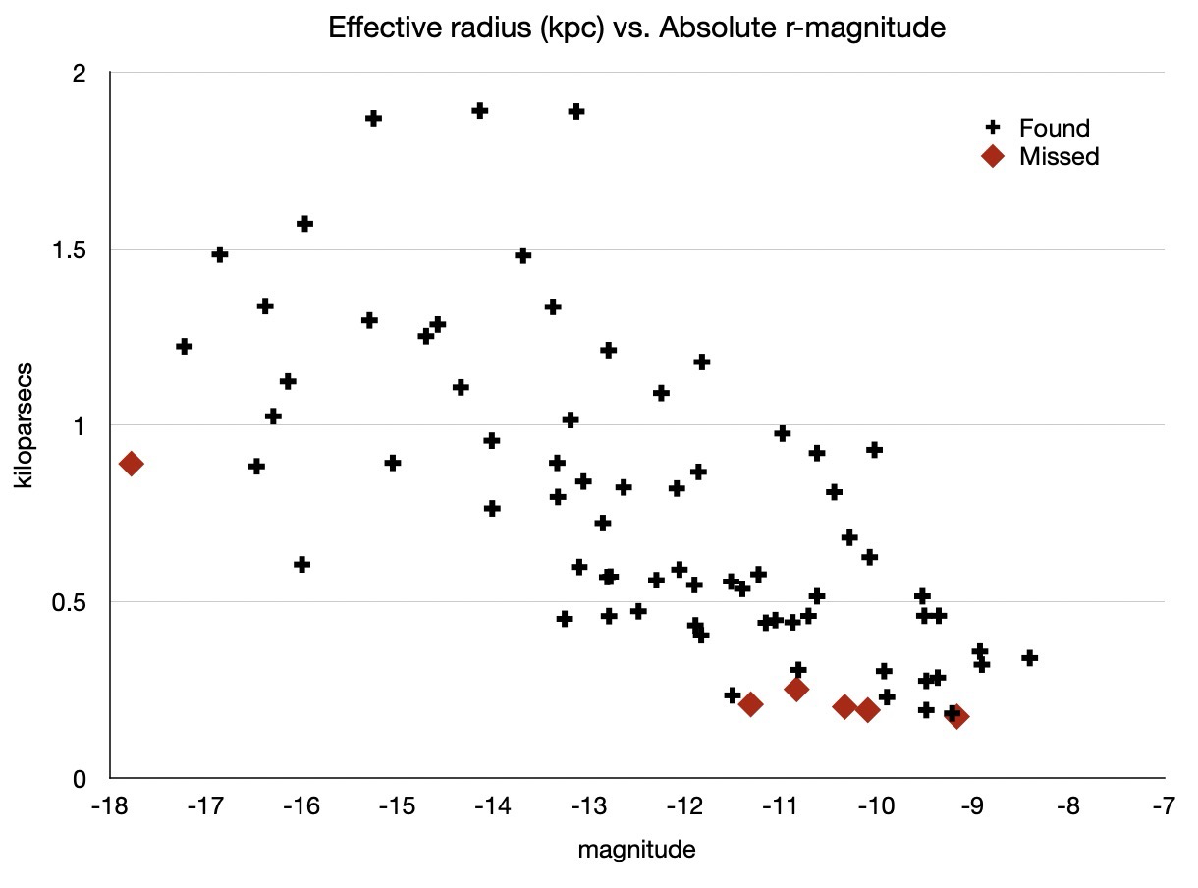

Results: F11 Tile
Ultra Diffuse Galaxy (UDG) Cutoff
Found 71/79 (90%) of diffuse galaxies from detection algorithm
Computer has advantage with fainter/smaller objects
14 additional diffuse galaxy candidates from visual inspection
Effective radius
Brighter
Fainter
Absolute r-magnitude
12

Slide 14
Summary
Our current understanding of diffuse galaxies is limited → need more examples
From visual identification, we found:
  90% of the same objects as an established automated detection algorithm
  Plus 14 diffuse galaxies this algorithm missed!
13

Slide 15
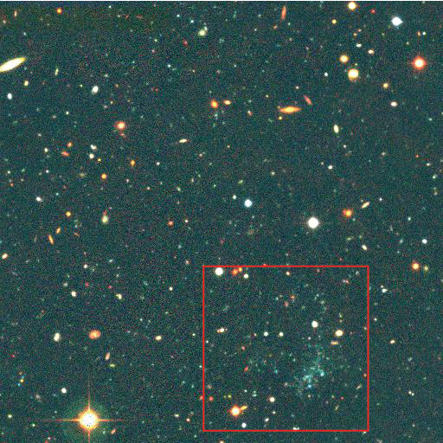
Future Work
Launching Zooniverse project
Examining all of Fornax
Adding to the completeness of automated diffuse galaxy catalogs
Extending coverage to the Virgo Cluster
Simultaneously searching for “blue blobs”
Blue blob!
(Image Credit: Next Generation Virgo Cluster Survey/Canada-France-Hawaii Telescope)
14

Slide 16
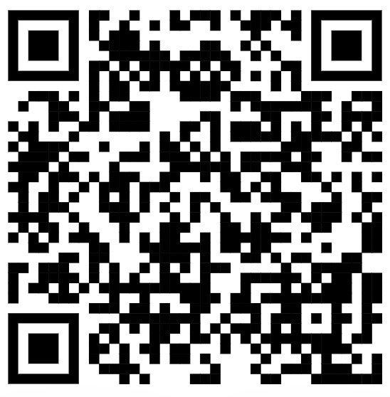
Thank you!
Acknowledgements
Prof. David Sand and Dr. Michael Jones, Department of Astronomy and Steward Observatory
Arizona Space Grant Consortium
NASA
Zooniverse
Sign up for our project’s launch!

Slide 17
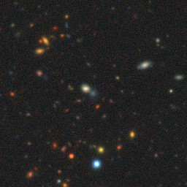
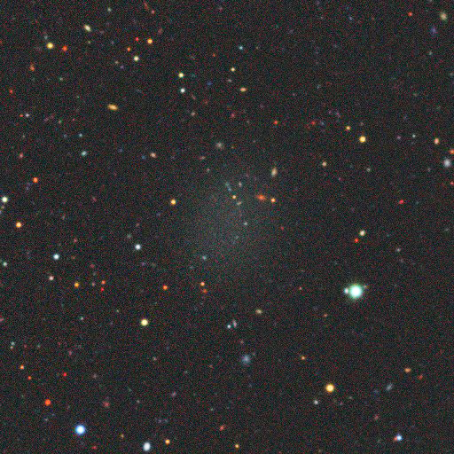
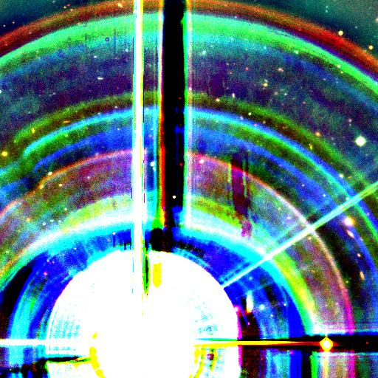
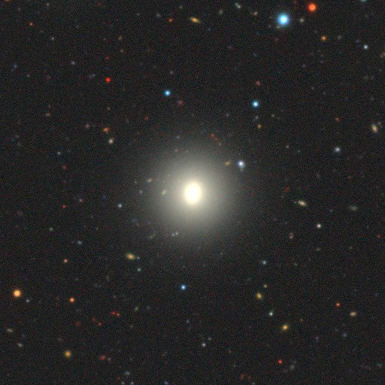
Additional Images for Questions
Missed Objects
Bright Star in Image Frame
UDG Example

